Slide 1
A LoRaWAN mesh network for agricultural sensor data
Daniel Pistorino
Daniel.pistorino@ufl.edu
Oliver Philipp
ophilipp@ufl.edu
LoRaWAN Drone Integration IoT4AG, IMG, and Dr. David Arnold
September 6th, 2024

Slide 2
Presentation Guide
Introduction/Existing Work
Descriptions
Block Diagrams
Gantt Chart

Slide 3
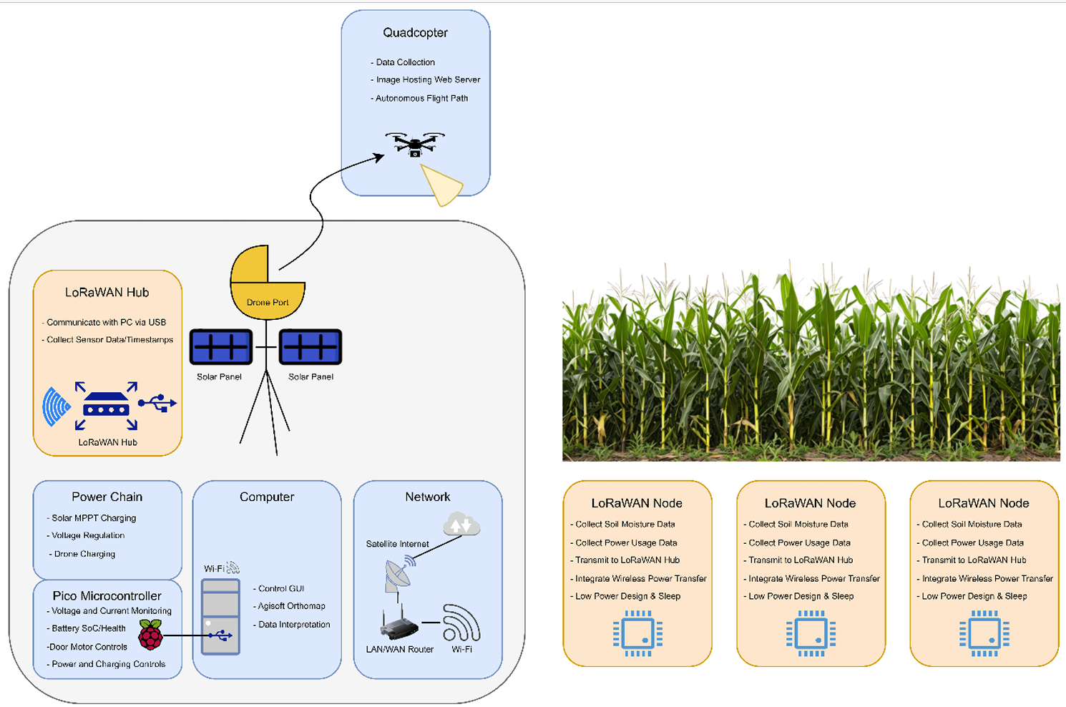
Introduction
The Agriculture industry can improve crop yield by analyzing environmental localized data.
Existing sensors measure soil nutrient, moisture, and temperature levels, but deployment interferes with Agricultural process-flow.
The aim of this project is to design the LoRaWAN network components for collecting sensor data from subterranean nodes.
Analysis of hub and node designs will include power efficiency, signal data errors, and SoC tracking.
Fig. 1 LoRaWAN Drone Implementation block diagram, showing the project design goals in peach.

Slide 4
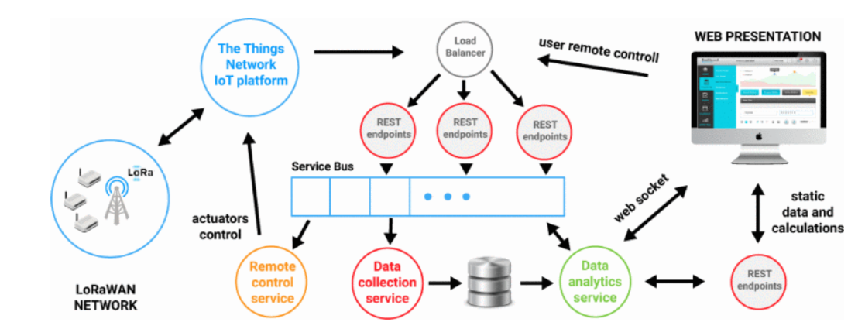
Existing Work
Fig 2. LoRaWAN Network diagram from motivational research.
Existing work was published back in June 2018 by a group of researchers that found that LoRaWAN networks are ideal for IoT4Ag applications due to the low power requirements and long transmission range, making it better than other protocols like Zigbee and BTLE[1].
The proof of concept for their system measured temperature, atmospheric and soil properties of farmland and was able to make decisions on when the irrigation system would turn on and off, allowing for a much more efficient system [1].

Slide 5
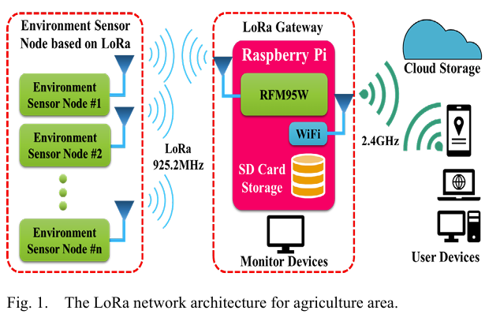
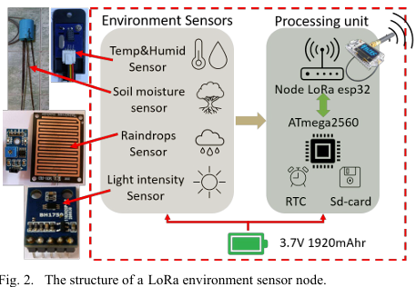
Existing Work
Above-ground LoRaWAN prototype
Subterranean sensors
925.2 MHz transmission
600 meters.
W. Chanwattanapong, S. Hongdumnuen, B. Kumkhet, S. Junon, P. Sangmahamad, “LoRa Network Based Multi-Wireless Sensor Nodes and LoRa Gateway for Agriculture Application.” IEEE, DOI: 10.1109/RI2C51727.2021.9559804, 2021

Slide 6
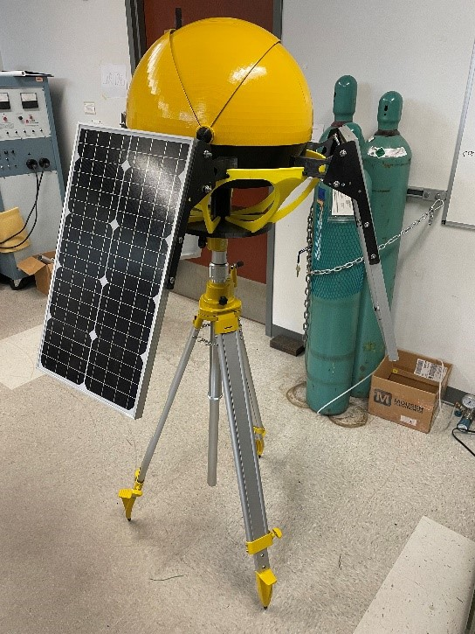
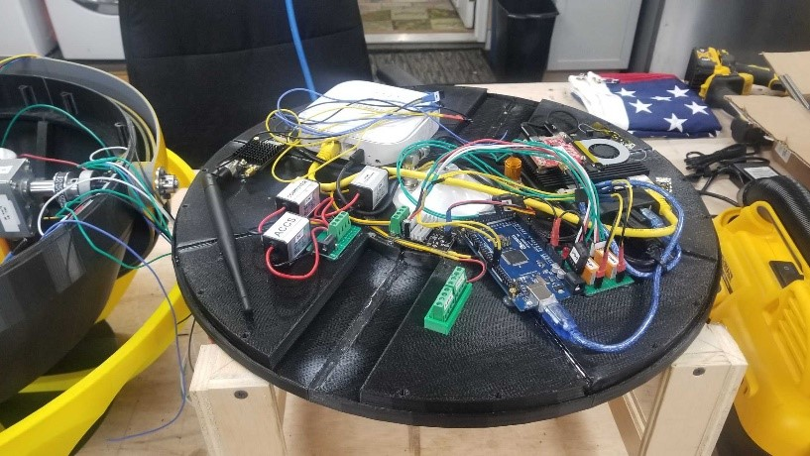
Existing Work
Fig. 4: Closed drone port (yellow) with attached solar panel.
Fig. 5: Drone port internal components.
Drone
Autonomous flight path
Aerial field pictures for crop analysis.
Drone Port
Solar charging
Starlink Internet connection
VPN station monitoring

Slide 7
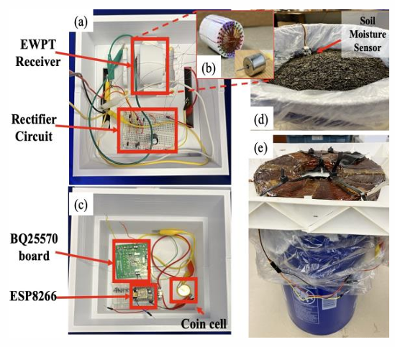
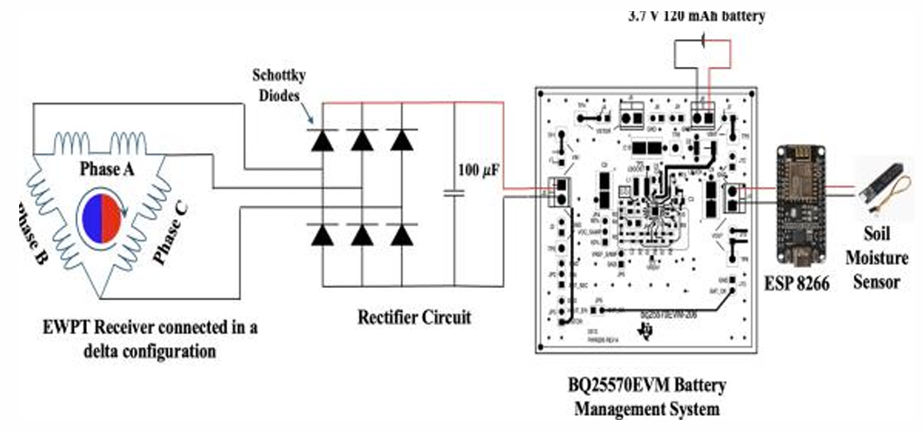
Existing Work
Wireless Power Transmission
Rotating magnet
0.272W-h charging
3.7V, 120mA-h battery
Vernon S. Crasto1, William R Eisenstadt2 and David P. Arnold, “Wirelessly Powered Buried Soil Moisture Sensor System.”

Slide 8
Project Description
LoRaWAN Hub
The LoRaWAN Hub system integration will take place on the existing drone port and will connect to the local PC via USB.
Data received from the LoRaWAN Nodes will be relayed from a gateway node to the Hub and communicated to the PC where that data is displayed on the drone port GUI.
Any control signals from the GUI will also be sent to the LoRaWAN hub and transmitted to the relevant LoRaWAN node(s) for easy configurtation changes without the need for physical access to the LoRaWAN node(s).

Slide 9
Project Description
LoRaWAN Node
Design specifications
Log sensor data (I²C and UART), system health, and power use.
Transmit data to LoRaWAN gateway.
Battery powered with wireless power charging.
Energy goal: <120 mAh per day.
Power Management
TI BQ25570EVM-206
3.7V 120 mAh battery (EEMB LIR245)
Microcontroller
Low-power sleep requirements
STMicroelectronics STM32 microcontrollers

Slide 10
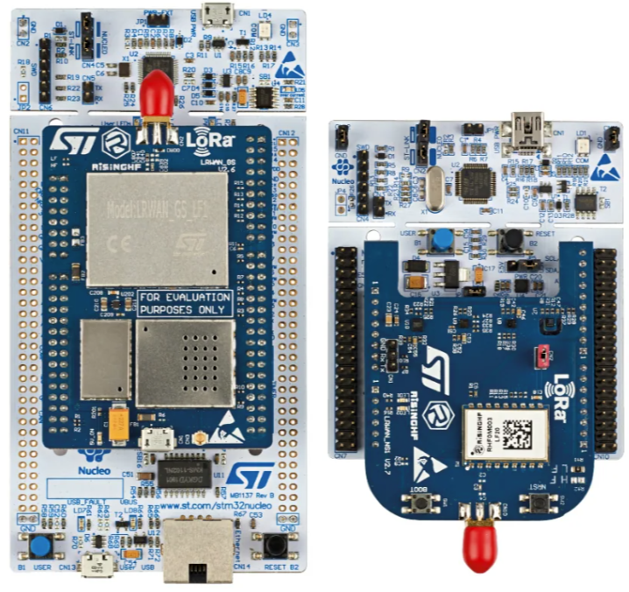
Project Description
LoRaWAN Hardware
STMicroelectronics
STM32 Development Boards
gateway (NUCLEO-F746ZG)
node (NUCLEO-L073RZ)
RisingHF
Gateway expansion
LRWAN_GS_LF1 LoRa® LF band (433/470 MHz)
Sensor expansion
LRWAN_NS1 LoRa® LF band (433/470 MHz)

Slide 11
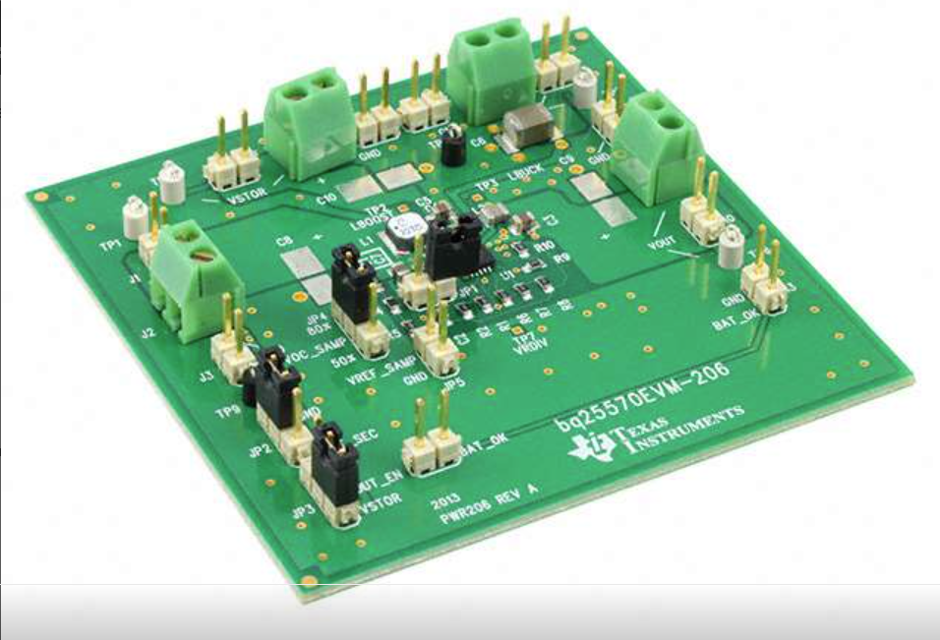
Project Description
Power Harvesting
TI’s BQ25570 IC Test Board
Battery charged via boost converter
Stable power supplied through buck converter
Battery status indicator

Slide 12
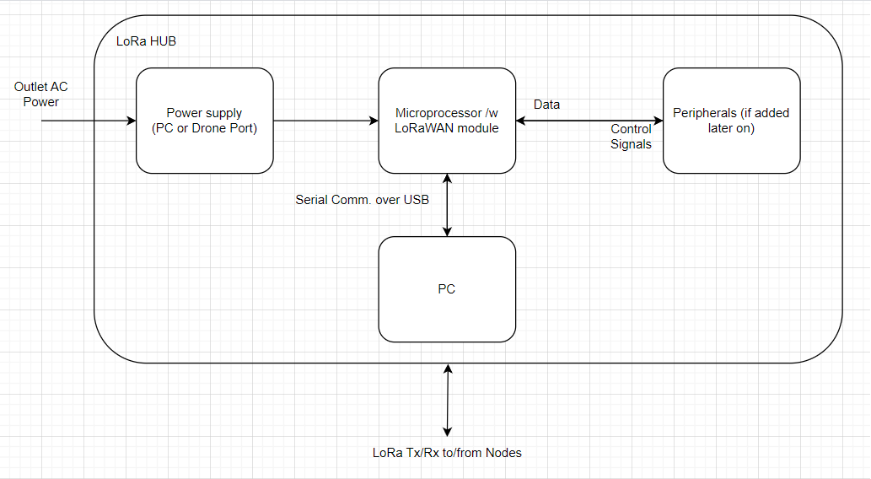
Hardware Block Diagram
LoRaWAN Hub
Fig. 4: LoRaWAN Hub hardware signal block diagram.

Slide 13
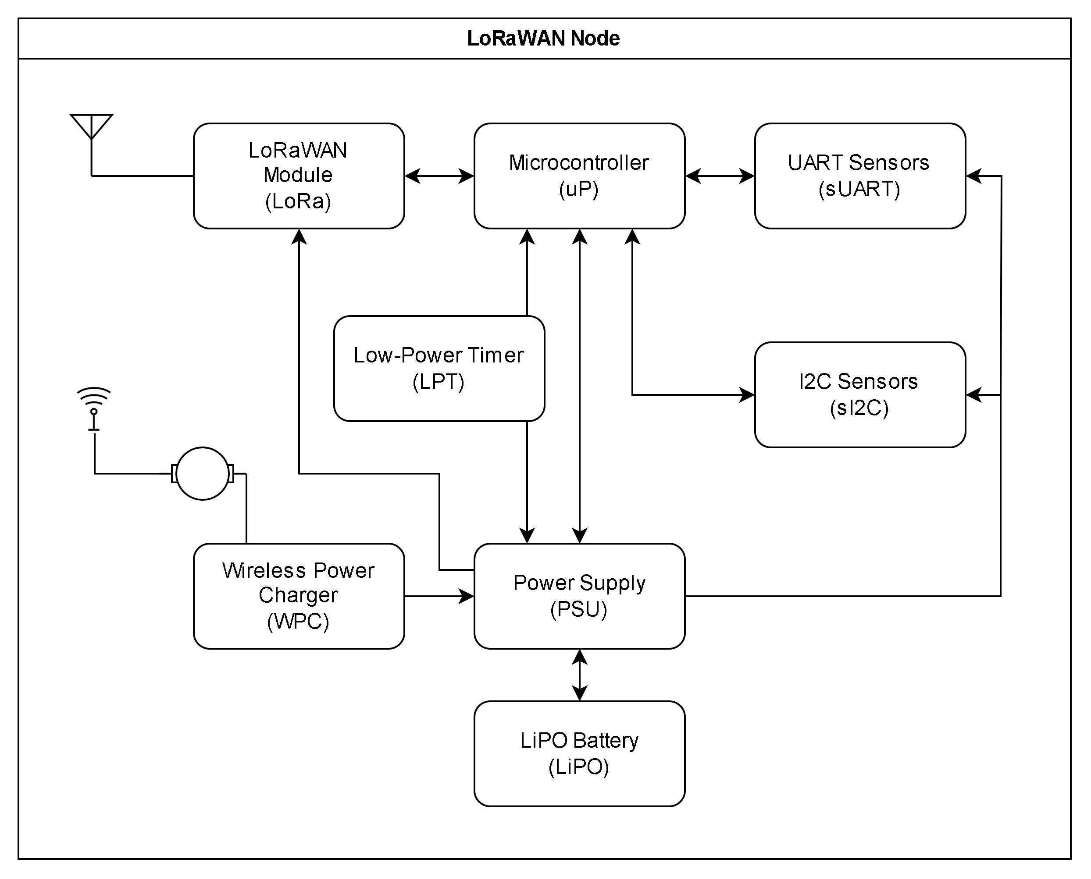
Hardware Block Diagram
LoRaWAN Node

Slide 14
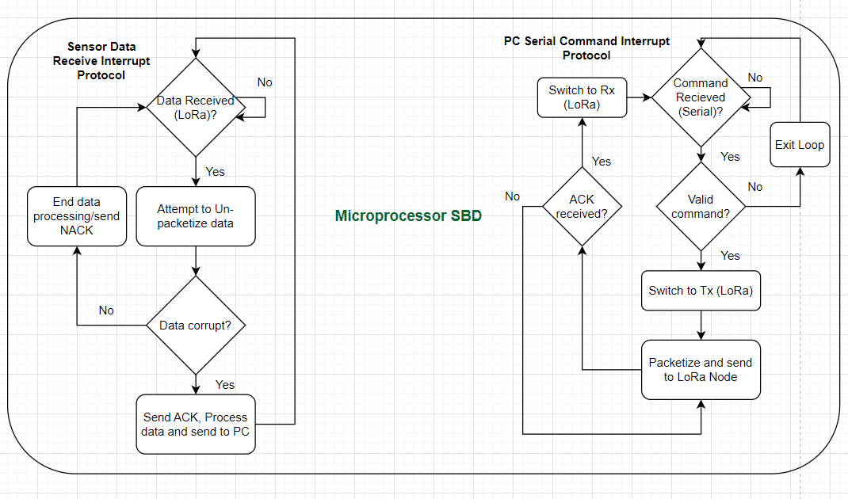
Software Block Diagram
LoRaWAN Hub
Fig. 6: LoRaWAN Hub software signal block diagram.

Slide 15
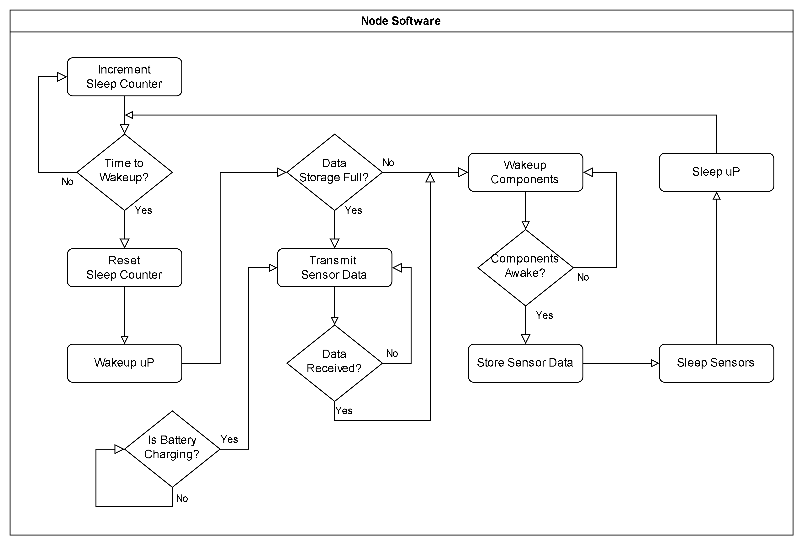
Software Block Diagram
LoRaWAN Node

Slide 16
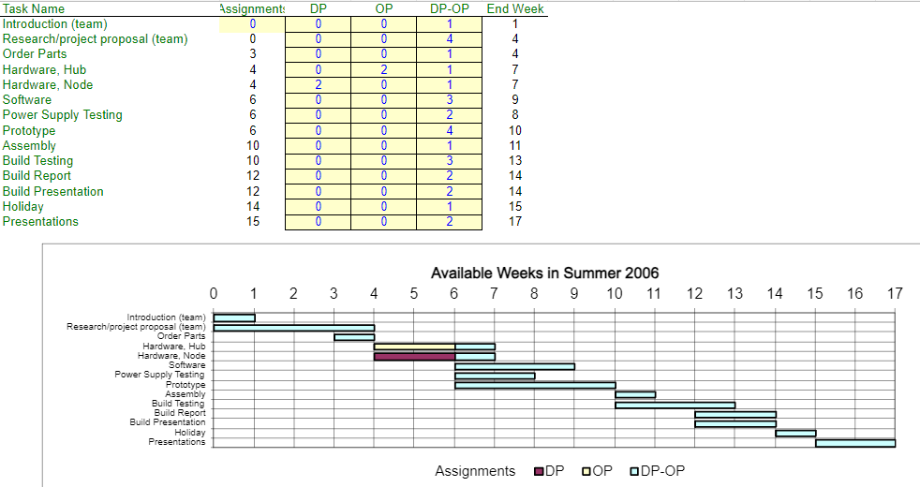
Gantt Chart
LoRaWAN Drone Integration
Fig. 4: LoRaWAN Integration Gantt Chart.

Slide 17
Cited Works
[1] D. Davcev, K. Mitreski, S. Trajkovic, V. Nikolovski, and N. Koteli, “IOT agriculture system based on Lorawan,” 2018 14th IEEE International Workshop on Factory Communication Systems (WFCS), Jun. 2018. doi:10.1109/wfcs.2018.8402368

